Slide 1
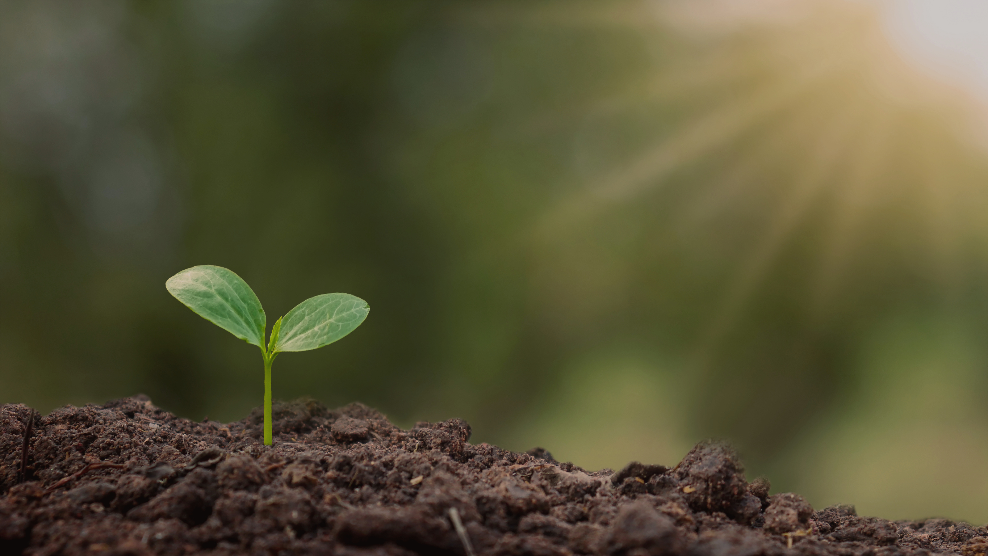
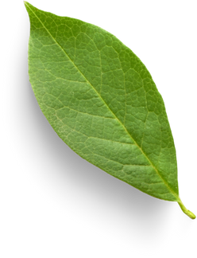
Student’s names: Fanni Mikus, Daniel Szalai
School: Szinyei Merse Pal High School
Artificial fertilizers in the modern food industry
The effects of Cu II-ions on the germination of radish and white mustard seeds

Slide 2
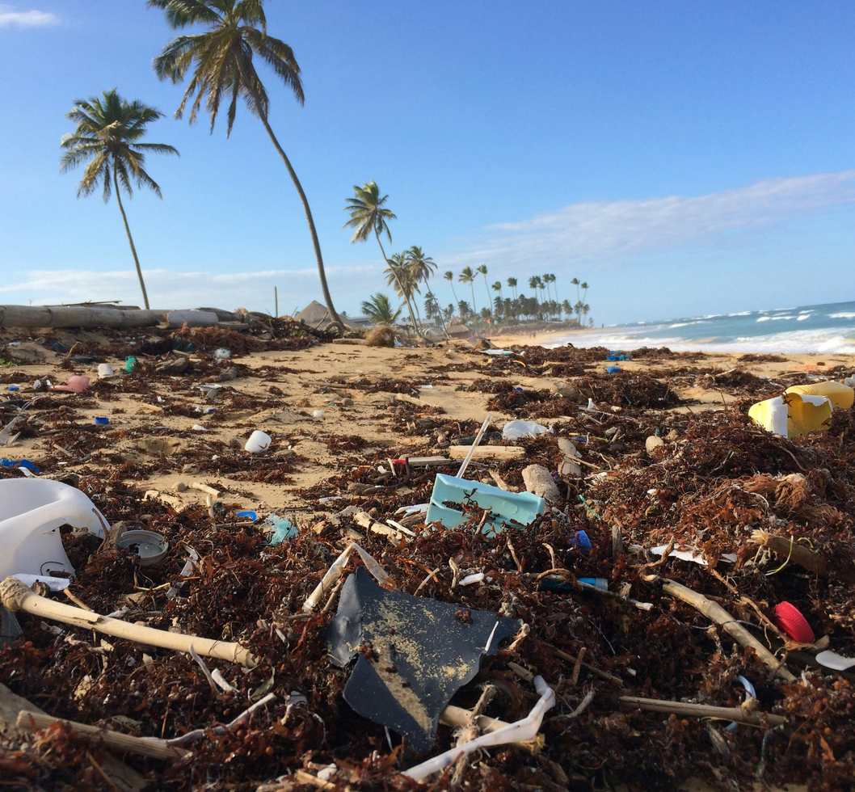
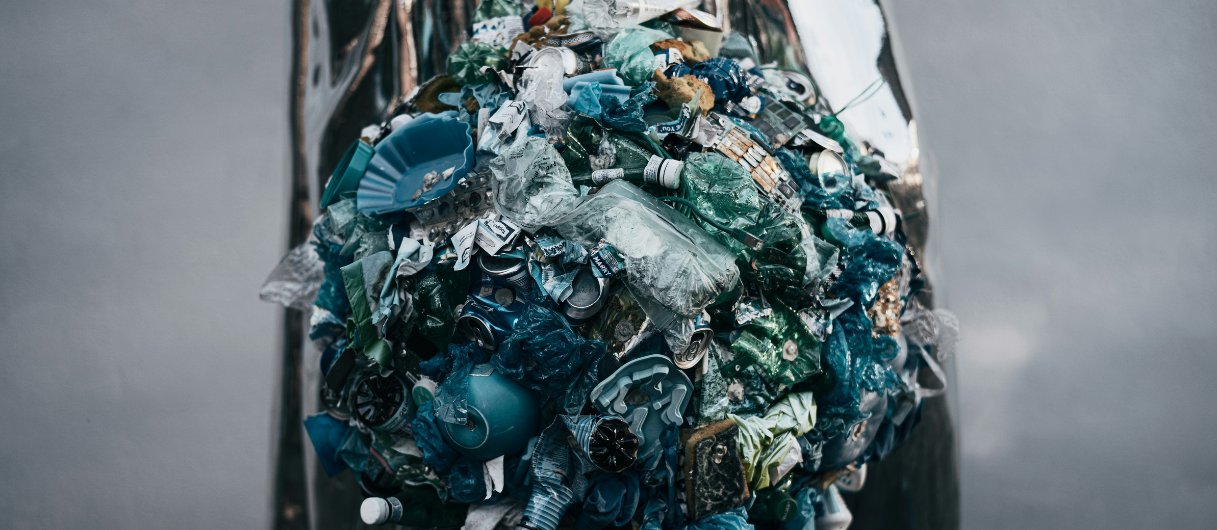
Heavy metal pollution, like copper in soil, harms plant growth and food safety. While copper is essential in small amounts, high concentrations can be toxic, affecting seed germination and nutrient uptake.
Heavy metals and environmental pollution

Slide 3
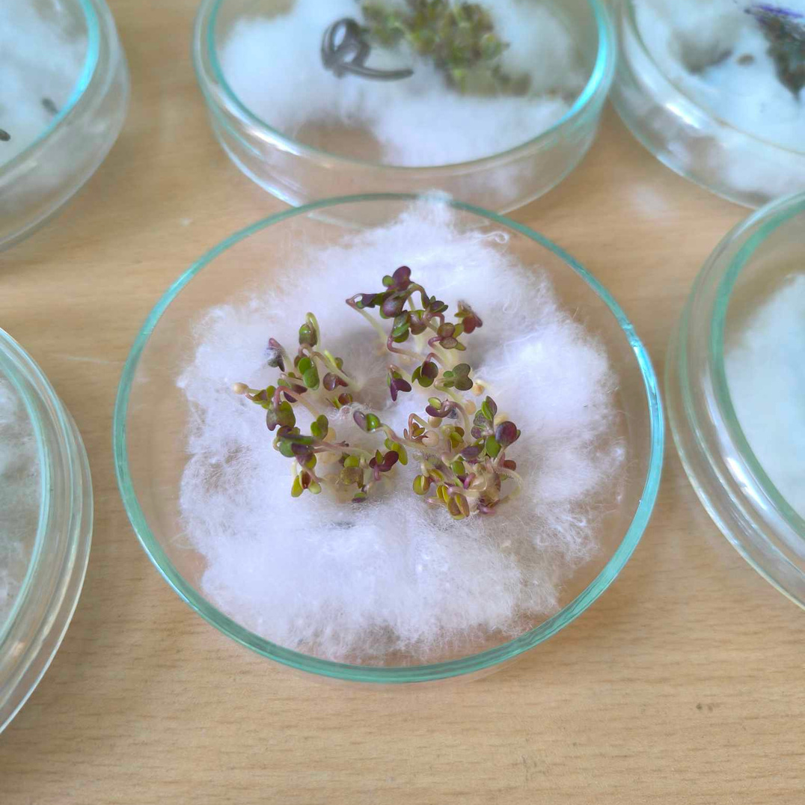
Our project:
The goal of the study was to investigate the effect of copper ions (Cu²⁺) on the seeds, as well as to measure the uptake of copper by the seedlings.

Slide 4
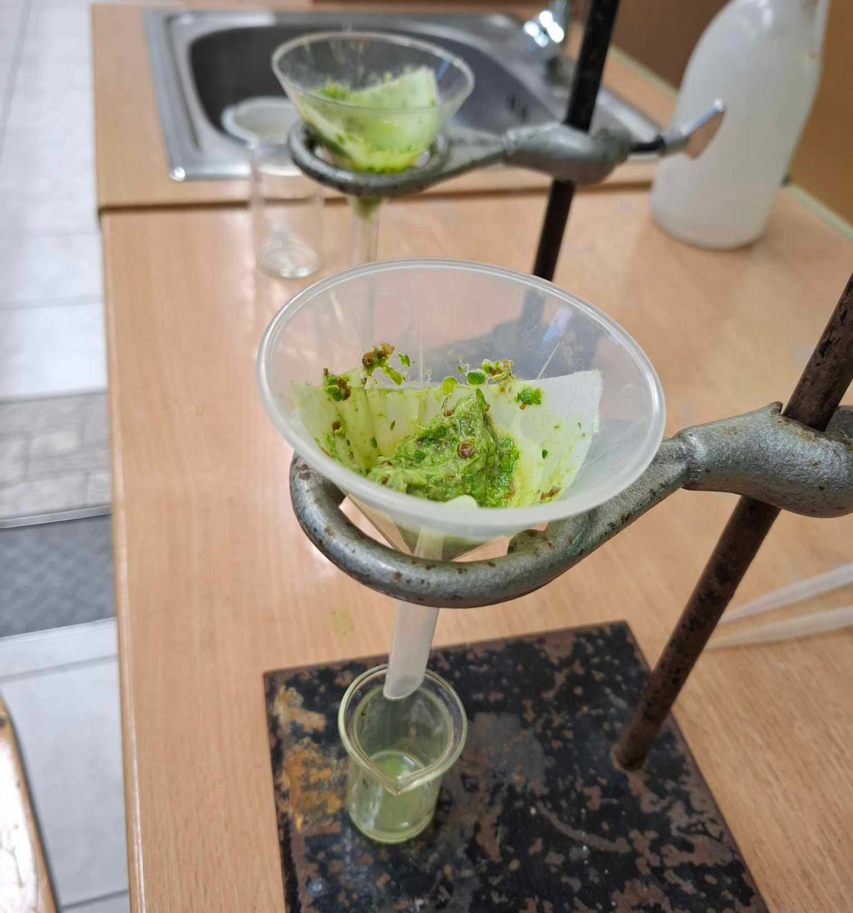
The process:
01
Seed selection
02
Copper solution preparation
03
Germination setup
04
Germination monitoring
05
Copper uptake measurement
06
Data analysis

Slide 5
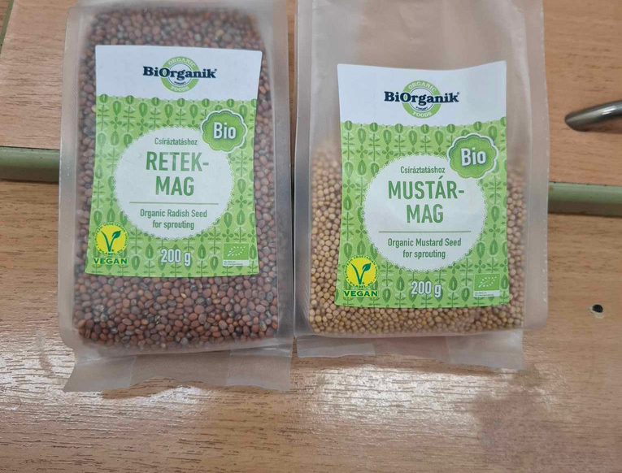
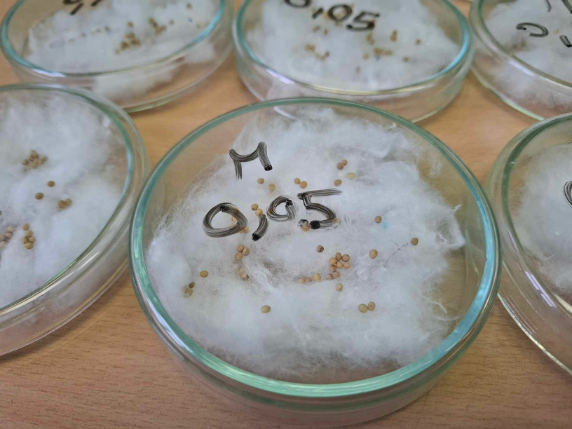
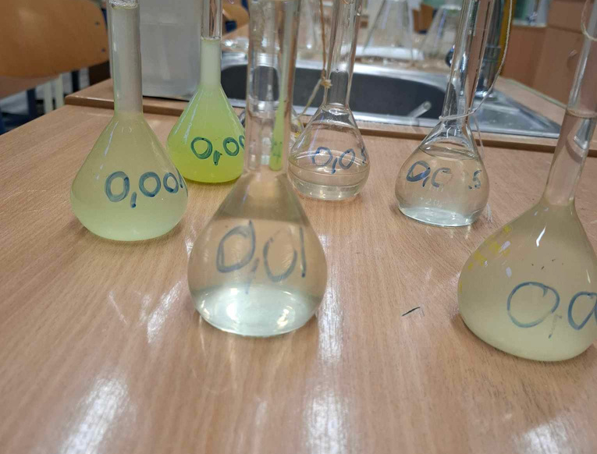
Copper Solution Preparation
Copper(II) sulfate (CuSO₄) solutions of varying concentrations were prepared using distilled water.
Germination Setup
Seed Selection
- 50 seeds were placed in each petri dish.
- Each dish was filled with a specific concentration of CuSO₄ solution.
- Cotton wool was placed at the bottom of each petri dish to keep seeds hydrated.
- Dishes were incubated in a bright room at 22°C for 7 days.
Organic mustard
(Sinapis alba) and radish (Raphanus sativus) seeds were chosen for the experiment.

Slide 6
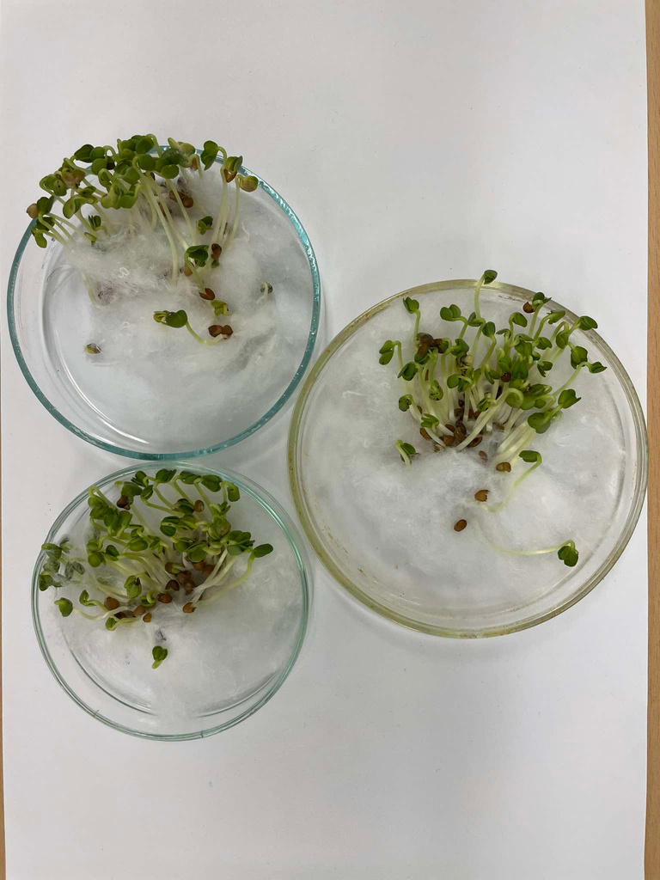
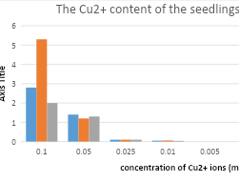
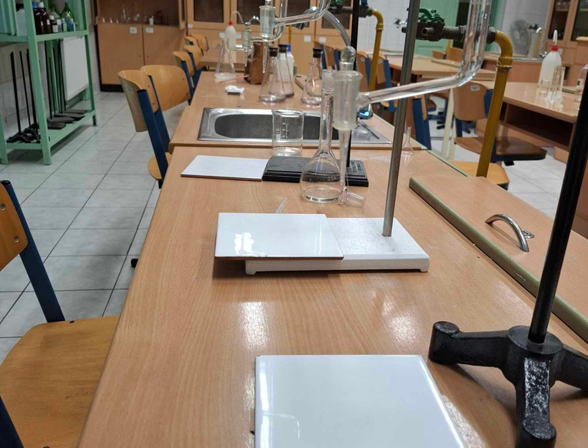
Copper Uptake Measurement
- Seedlings were ground and filtered.
- Iodometric titration was used to determine the Cu²⁺ content in the seedlings.
- The amount of copper absorbed was calculated.
Germination Monitoring
Data Analysis
- The number of germinated seeds was counted after 7 days.
- The weight of the germinated seeds was recorded.
The relationship between Cu²⁺ concentration, germination rate, seedling weight, and copper content in the seedlings was analyzed.

Slide 7

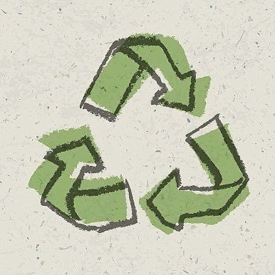

In conclusion, mustard seeds absorb heavy ions more than radish. Plants take in Cu²⁺ using COPT1, store it in root complexes, and transport it to shoots. Excess copper causes stunted growth, leaf bronzing, and necrosis.
CONCLUSIONS

Slide 8
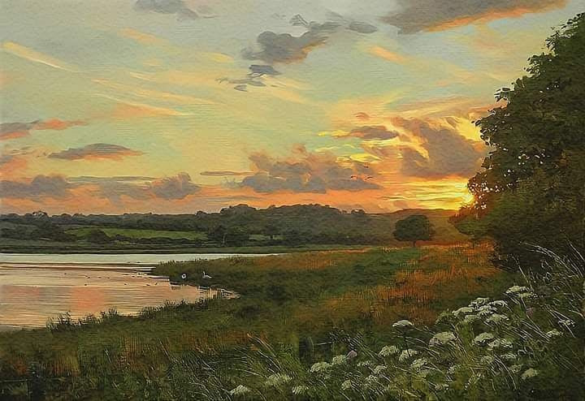

OUR WEBSITE
Visit our website to learn more about our project, recycling, and ways to help the planet. Explore tips, resources, and how you can make a difference!
https://plants4life2.webnode.hu

Slide 9
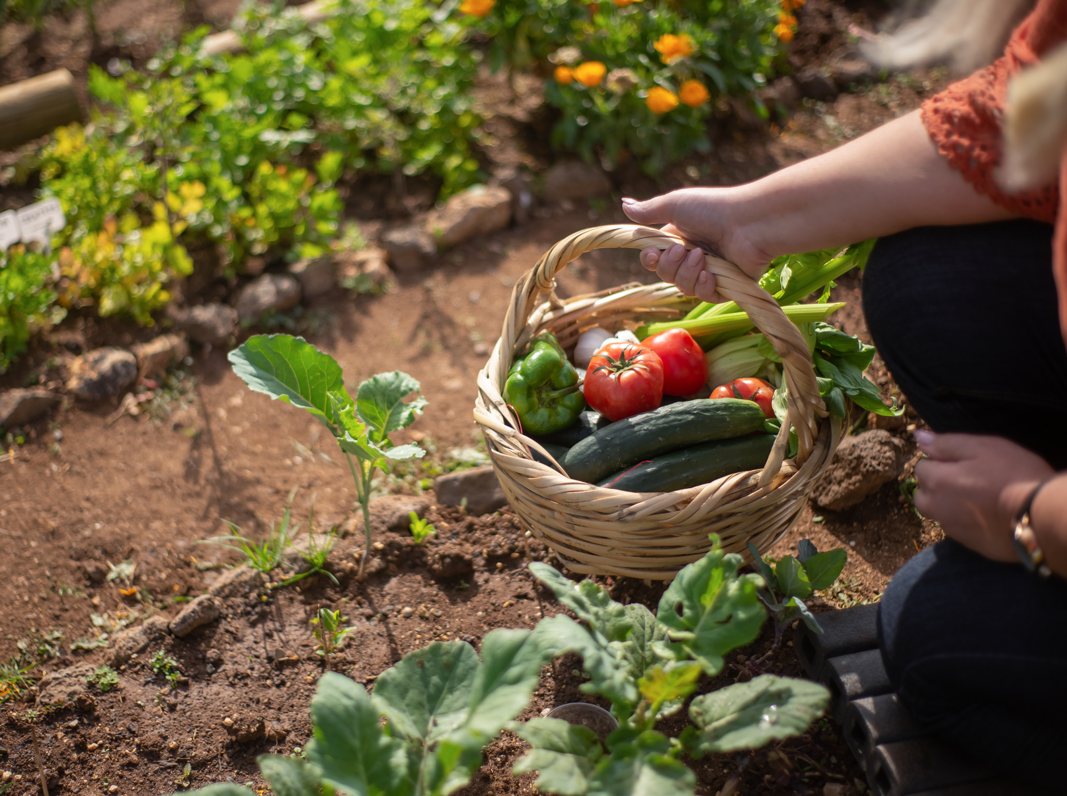
Thank You For Your Attention!

